Slide 1
ELECTRONICS L1
Electronics Definition – Electronics is the branch of science that deals with the study of flow and control of electrons (electricity) and the study of their behavior and effects in vacuums, gases, and semiconductors, and with electronic components, devices, or equipment.
Difference Between Electrical and Electronics Definition
Electronics deals with flow of charge (electron) through non-metal conductors (semiconductors).
Electrical deals with the flow of charge through metal conductors.

Slide 2
The Structure of the Atom
Structure Of The Atom: Our current model of the atom can be broken down into three constituents parts – protons, neutron, and electrons. Each of these parts has an associated charge, with protons carrying a positive charge, electrons having a negative charge, and neutrons possessing no net charge.

Slide 3
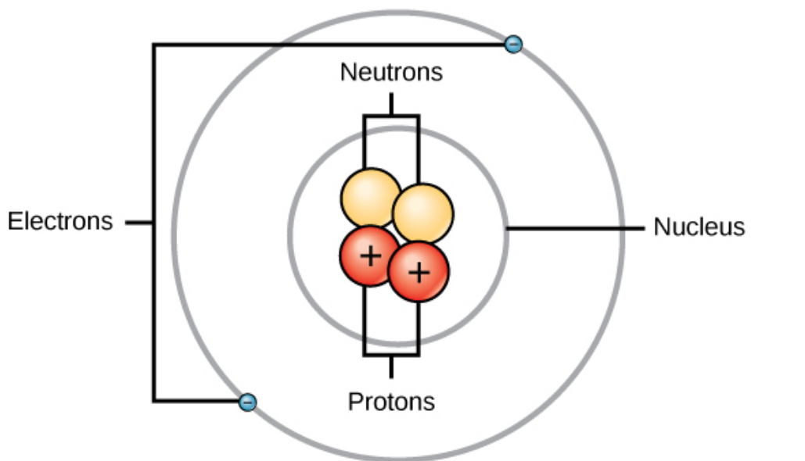

Slide 4
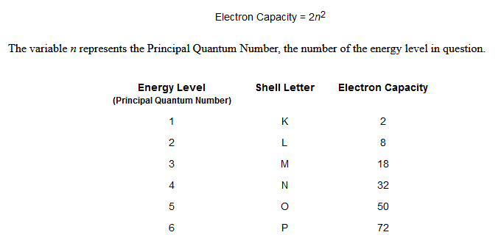
ELECTRONS
Number of electrons fit in each shell around an atom

Slide 5
Valence Electrons
The electrons in the outermost orbit of an atom are known as valence electrons.
The outermost orbit can have a maximum of 8 electrons i.e. the maximum number of valence
electrons can be 8. The valence electrons determine the physical and chemical properties of a material. These electrons determine whether or not the material is chemically active; metal , non-metal , a gas or solid. These electrons also determine the electrical properties of a material.

Slide 6
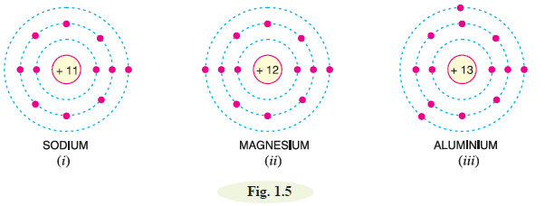
Electrical conductivity
materials are generally classified into conductors, insulatorsand semi-conductors. As a rough rule, one can determine the electrical behaviour of a material from the number of valence electrons as under :
(i) When the number of valence electrons of an atom is less than 4 the material is usually a metal and a conductor. Examples are sodium, magnesium
and aluminium which have 1, 2 and 3 valence electrons respectively (See Fig. 1.5).

Slide 7
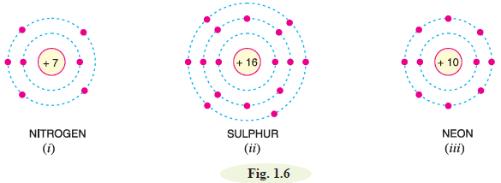
(ii) When the number of valence electrons of an atom is more than 4, the material is usually a non-metal and an insulator. Examples are nitrogen, sulphur and neon which have 5, 6 and 8 valence
electrons respectively (See Fig. 1.6).

Slide 8
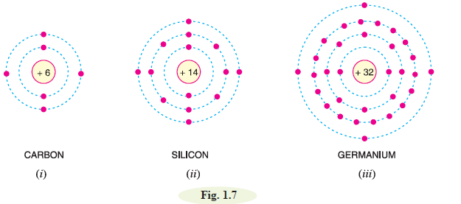
(iii) When the number of valence electrons of an atom is 4 (i.e. exactly one-half of the maximum 8 electrons), the material has both metal and non-metal properties and is usually a semiconductor.
Examples are carbon, silicon and germanium (See Fig. 1.7).

Slide 9
Free Electrons
The valence electrons of different materials possess different energies. The greater the energy of a
valence electron, the lesser it is bound to the nucleus. In certain substances, particularly metals, the valence electrons possess so much energy that they are very loosely attached to the nucleus. These loosely attached valence electrons move at random within the material and are called free electrons. The valence electrons which are very loosely attached to the nucleus are known as free electrons.

Slide 10
Band Gap
Recall that the valence shell of an atom represents a band of energy levels and that the valence electrons are confined to that band. When an electron acquires enough additional energy, it can leave the valence shell, become a free electron, and exist in what is known as the conduction band. The difference in energy between the valence band and the conduction band is called an energy gap or band gap. This is the amount of energy that a valence electron must have in order to jump from the valence band to the conduction band. Once in the conduction
band, the electron is free to move throughout the material and is not tied to any given atom.

Slide 11
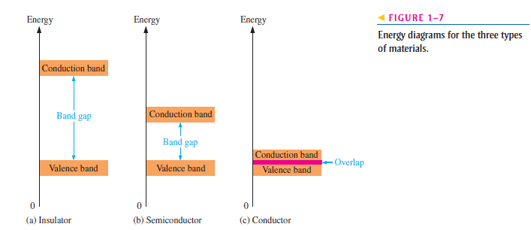

Slide 12
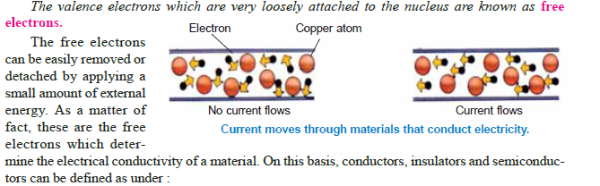
(i) A conductor is a substance which has a large number of free electrons. When potential difference is applied across a conductor, the free electrons move towards the positive terminal of supply, constituting electric current.
(ii) An insulator is a substance which has practically no free electrons at ordinary temperature. Therefore, an insulator does not conduct current under the influence of potential difference.
(iii) A semiconductor is a substance which has very few free electrons at room temperature. Consequently, under the influence of potential difference, a semiconductor practically conducts no current.

Slide 13
Active and passive components
Components can be classified as passive and active, or electromechanic. The strict physics definition treats passive components as ones that cannot supply energy themselves(e,g resistors,capacitors ets) whereas a battery would be seen as an active component since it truly acts as a source of energy(e,g diodes,transistors ets)

Slide 14

Semiconductor
Resistivity is a measure of the resistance of a given size of a specific material to electrical conduction.
A semiconductor is a substance which has resistivity (10¯4 to 0.5 Ωm) in between conductors
and insulators e.g. germanium, silicon, selenium
carbon etc.
You may wonder, when a semiconductor is neither a good conductor nor an insulator, then
why not to classify it as a resistance material ? The answer shall be readily available if we study the following table :

Slide 15
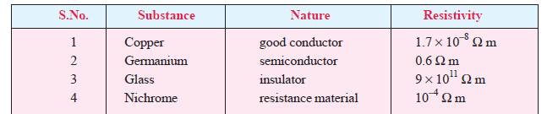
Comparing the resistivities of above materials, it is apparent that the resistivity of germanium (semiconductor) is quite high as compared to copper (conductor) but it is quite low when compared with glass (insulator). This shows that resistivity of a semiconductor lies in between conductors and insulators. However, it will be wrong to consider the semiconductor as a resistance material. For example, nichrome, which is one of the highest resistance material, has resistivity much lower than germanium(Alloy ).This shows that electrically germanium cannot be regarded as a conductor or insulator or a resistance material. This gave such substances like germanium the name of semiconductors.

Slide 16
Nichrome, a non-magnetic alloy that is commonly made up of 80% nickel and 20% chromium, has a resistivity ranging from 1.10 × 10⁻⁶ Ωm to 1.50 × 10⁻⁶ Ωm (0.00000110 Ωm to 0.00000150 Ωm) and a very high melting point (~1400 °C).

Slide 17
It is interesting to note that it is not the resistivity alone that decides whether a substance is semiconductor or not. For example, it is just possible to prepare an alloy whose resistivity falls within the range of semiconductors but the alloy cannot be regarded as a semiconductor. In fact, semiconductors have a number of peculiar properties which distinguish them from conductors, insulators and resistance materials.

Slide 18
Properties of Semiconductors
(i) The resistivity of a semiconductor is less than an insulator but more than a conductor.
(ii) Semiconductors have negative temperature co-efficient of resistance i.e. the resistance
of a semiconductor decreases with the increase in temperature and vice-versa. For example, germanium is actually an insulator at low temperatures but it becomes a good conductor at high temperatures.
(iii) When a suitable metallic impurity (e.g. arsenic, gallium etc.) is added to a semiconductor, its
current conducting properties change appreciably. This property is most important property

Slide 19
Commonly Used Semiconductors
There are many semiconductors available, but very few of them have a practical application in electronics. The two most frequently used materials are germanium (Ge) and silicon (Si). It is because the energy required to break their co-valent bonds (i.e. energy required to release an electron from their valence bands) is very small; being about 0.7 eV for germanium and about 1.1 eV for silicon. Therefore, we shall discuss these two semiconductors in detail.

Slide 20
ASSIGNMENT 1
WRITE SHORT NOTES ON
.WHY CARBON IS NOT USED AS A SEMICONDUCTOR MATERIAL
.WHICH SEMICONDUCTOR MATERIAL IS MOST USED AND WHY
.COMPARE Si AND Ge SEMICONDUCTORS
.WHY A SEMICONDUCTOR IS NOT TO CLASSIFY IT AS A RESISTANCE MATERIAL
.THE EFFECT BOF REVERSE BIASING OF PN JUCTION
WRITE SHORT NOTES ON OPERATION AND APPLICATION
RECTIFYING A VOLTAGE, SUCH AS TURNING THE AC INTO DC VOLTAGES.
ISOLATING SIGNALS FROM A SUPPLY.
VOLTAGE REFERENCE.
CONTROLLING THE SIZE OF A SIGNAL.
MIXING SIGNALS.
DETECTION SIGNALS.
LIGHTING SYSTEMS.
LASER DIODES.

Slide 21
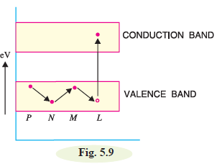
The hole current
can be beautifully explained in terms of energy
bands. Suppose due to thermal energy, an electron
leaves the valence band to enter into the conduction
band as shown in Fig. 5.9. This leaves a vacancy at L. Now the valence electron at M comes to fill the hole at L. The result is that hole disappears at L and appears at M. Next, the valence electron at N moves into the hole at M. Consequently, hole is created at N. It is clear that
valence electrons move along the path PNML
whereas holes move in the opposite direction i.e.
along the path LMNP.

Slide 22
N-TYPE AND P-TYPE SEMICONDUCTORS
Semiconductive materials do not conduct current well and are of limited value in their intrinsic state. This is because of the limited number of free electrons in the conduction band and holes in the valence band. Intrinsic silicon (or germanium) must be modified by increasing the number of free electrons or holes to increase its conductivity and make it useful in electronic devices. This is done by adding impurities to the intrinsic material. Two types of extrinsic (impure) semiconductive materials, n-type and p-type, are the key building blocks for most types of electronic devices.

Slide 23
Since semiconductors are generally poor conductors, their conductivity can be drastically increased by the controlled addition of impurities to the intrinsic (pure) semi conductive material. This process, called doping, increases the number of current carriers (electrons or holes). The two categories of impurities are n-type and p-type.
N-Type Semiconductor
To increase the number of conduction-band electrons in intrinsic silicon, pentavalent impurity
atoms are added. These are atoms with five valence electrons such as arsenic (As),phosphorus (P), bismuth (Bi), and antimony (Sb).

Slide 24
As illustrated in Figure 1–17, each pentavalent atom (antimony, in this case) forms covalent bonds with four adjacent silicon atoms. Four of the antimony atom’s valence electrons are used to form the covalent bonds with silicon atoms, leaving one extra electron.
This extra electron becomes a conduction electron because it is not involved in bonding. Because the pentavalent atom gives up an electron, it is often called a donor atom. The number of conduction electrons can be carefully controlled by the number of impurity atoms added to the silicon. A conduction electron created by this doping process does not leave a hole in the valence band because it is in excess of the number required to fill the valence band.

Slide 25
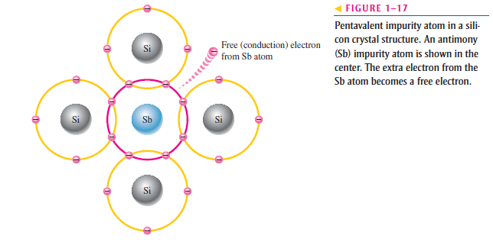

Slide 26
Majority and Minority Carriers Since most of the current carriers are electrons, silicon
(or germanium) doped with pentavalent atoms is an n-type semiconductor (the n stands for
the negative charge on an electron). The electrons are called the majority carriers in
n-type material. Although the majority of current carriers in n-type material are electrons,
there are also a few holes that are created when electron-hole pairs are thermally generated.
These holes are not produced by the addition of the pentavalent impurity atoms.
Holes in an n-type material are called minority carriers.

Slide 27
P-Type Semiconductor
To increase the number of holes in intrinsic silicon, trivalent impurity atoms are added. These are atoms with three valence electrons such as boron (B), indium (In), and gallium (Ga). As illustrated in Figure 1–18, each trivalent atom (boron, in this case) forms covalent bonds with four adjacent silicon atoms. All three of the boron atom’s valence electrons are used in the covalent bonds; and, since four electrons are required, a hole results when each trivalent atom is added. Because the trivalent atom can take an electron, it is often referred to as an acceptor atom. The number of holes can be carefully controlled by the number of trivalent impurity atoms added to the silicon. A hole created by this doping process is not accompanied by a conduction (free) electron.

Slide 28
Majority and Minority Carriers Since most of the current carriers are holes, silicon (or
germanium) doped with trivalent atoms is called a p-type semiconductor. The holes are the
majority carriers in p-type material. Although the majority of current carriers in p-type
material are holes, there are also a few conduction-band electrons that are created when
electron-hole pairs are thermally generated. These conduction-band electrons are not produced
by the addition of the trivalent impurity atoms. Conduction-band electrons in p-type
material are the minority carriers.

Slide 29
pn Junction
When a p-type semiconductor is suitably joined to n-type semiconductor, the contact surface is called pn junction.
Most semiconductor devices contain one or more pn junctions. The pn junction is of great importance because it is in effect, the control element for semiconductor devices. A thorough knowledge of the formation and properties of pn junction can enable the reader to understand the semiconductor
devices.

Slide 30
Properties of pn Junction
At the instant of pn-junction formation, the free electrons near the junction in the N region begin to diffuse across the junction into the P region where they combine with holes near the junction. The result is that N region loses free electrons as they diffuse into the junction. This creates a layer of positive charges (pentavalent ions) near the junction. As the electrons move across the junction, the P region loses holes as the electrons and holes combine

Slide 31
The result is that there is a layer of negative
charges (trivalent ions) near the junction. These two layers of positive and negative charges form the depletion region (or depletion layer). The term depletion is due to the fact that near the junction, the region is depleted (i.e. emptied) of charge carries (free electrons and holes) due to diffusion across the junction. It may be noted that depletion layer is formed very quickly and is very thin compared to the n region and the p region. For clarity, the width of the depletion layer is shown exaggerated.

Slide 32
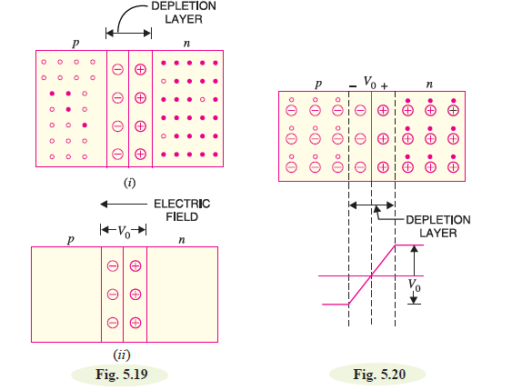

Slide 33
Once pn junction is formed and depletion layer created, the diffusion of free electrons stops. In other words, the depletion region acts as a barrier to the further movement of free electrons across the junction. The positive and negative charges set up an electric field. This is shown by a black arrow in Fig. 5.19
(i). The electric field is a barrier to the free electrons in the n-region. There exists a potential
difference across the depletion layer and is called barrier potential (Vo). The barrier potential of a pn
junction depends upon several factors including the type of semiconductor material, the amount of
doping and temperature. The typical barrier potential is approximately:
For silicon, Vo = 0.7 V ; For germanium, Vo = 0.3 V
Fig. 5.20 shows the potential (Vo) distribution curve.

Slide 34
Applying D.C. Voltage Across pn Junction or Biasinga pn Junction
In electronics, the term bias refers to the use of d.c. voltage to establish certain operating conditions
for an electronic device. In relation to a pn junction, there are following two bias conditions :
1. Forward biasing 2. Reverse biasing
1. Forward biasing. When external d.c. voltage applied to the junction is in such a direction
that it cancels the potential barrier, thus permitting current flow, it is called forward biasing.

Slide 35
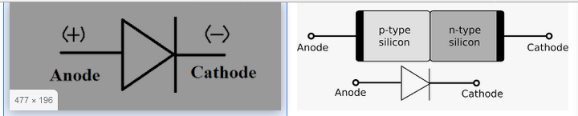
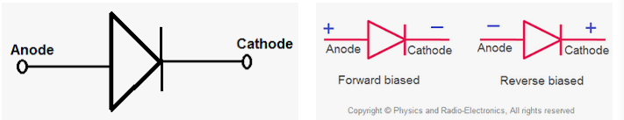
SYMBOL,FORWARD &REVERSE

Slide 36
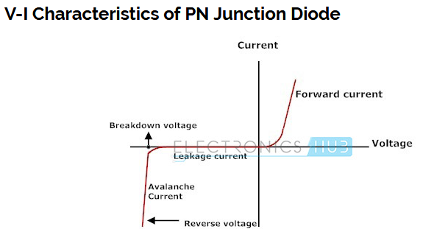

Slide 37
TYPES OF DIODES
Different Types of Diodes. There are several types of diodes are available for use in electronics design, namely; a Backward diode, BARITT diode, Gunn Diode, Laser diode, Light emitting diodes, Photodiode, PIN diode, PN Junction, Schottky diodes, Step recovery diode, Tunnel diode, Varactor diode and a Zener diode.

Slide 38
DIODE APPLICATIONS
Here are a few of the typical applications of diodes include:
Rectifying a voltage, such as turning the AC into DC voltages.
Isolating signals from a supply.
Voltage Reference.
Controlling the size of a signal.
Mixing signals.
Detection signals.
Lighting systems.
LASER diodes.

